Slide 1
PHOTOELECTRIC EFFECT Hiệu ứng quang điện
Nghia Tran 15th November

Slide 2
Agenda
Introduction
History
Mechanism
Applications

Slide 3

Introduction

Slide 4
Introduction
The photoelectric effect is a phenomenon in physics.
The effect is based on the idea that electromagnetic radiation is made of a series of particles called photons. When a photon hits an electron on a metal surface, the electron can be emitted. The emitted electrons are called photoelectrons.
The effect is also called the Hertz Effect.
Vocabulary:
Electromagnetic radiation: bức xạ điện từ
A series of particles: một loạt các hạt
Emitted electrons: các electron phát ra
Notes:
Hertz Effect - this name is not used often

Slide 5
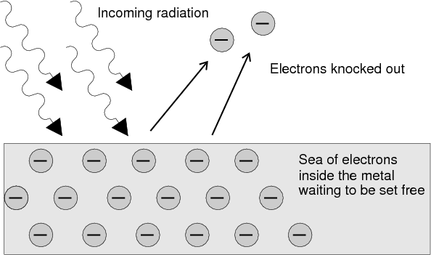
Introduction
Photons
Photoelectrons
Metal
Photoelectric effect
Notes:
to be more easier in understanding about photoelectric effect, please look at on this slide. I will show you how does the photoelectric effect work
The light from the specific source such as lamb or sun … hit the

Slide 6

History

Slide 7
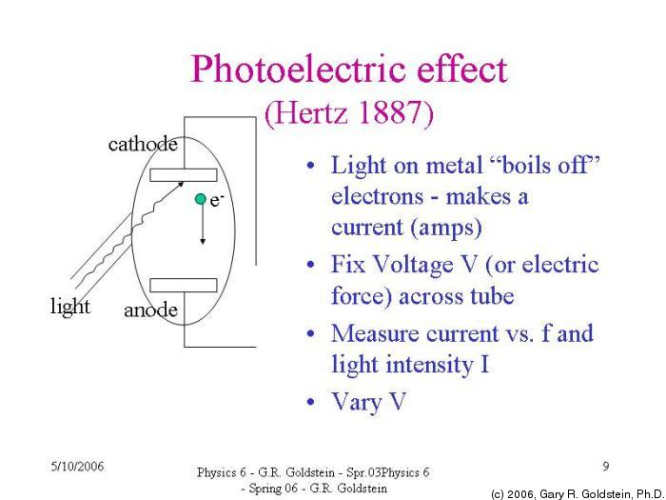
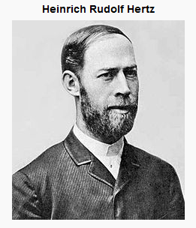
History
The spark jumps more readily
Đánh lửa dễ dàng hơn
1857 - 1894
Further studies were done to learn about the effect observed by Hertz, however it wasn't until 1905 that a theory was proposed that explained the effect completely.
Notes:
The first observation of the photoelectric effect was discovered by Heinrich Hertz in 1887. He reported that a spark jumped more
readily between two charged spheres if light was shining on them

Slide 8
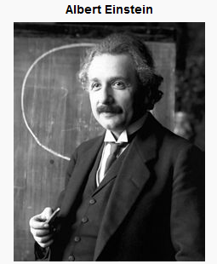
History
In 1905, the theory was proposed by Einstein and it made the claim that electromagnetic radiation had to be thought of as a series of particles, called photons, which collide with the electrons on the surface and emit them.
This theory ran contrary to the belief that electromagnetic radiation was a wave and thus it was not recognized as correct until 1916 when Robert Millikan preformed a series of experiments using a vacuum photo-tube to confirm the theory.
1879 - 1955
Einstein received the 1921 Nobel Prize in Physics for his discovery of the law of the photoelectric effect.
Vocabulary:
Collide(v): Va chạm
Contrary(adj): Trái ngược

Slide 9

Mechanism & Applications

Slide 10
Mechanism
Not every electromagnetic wave will cause the photoelectric effect, only radiation of a certain frequency or higher will cause the effect.
The minimum frequency needed is called the cutoff frequency or threshold frequency (This threshold frequency is a typical value for quality make the metal).
Vocabulary:
Electromagnetic wave: Sóng điện từ
Threshold frequency: Tần số ngưỡng

Slide 11

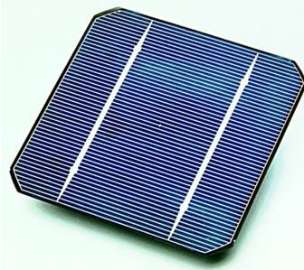
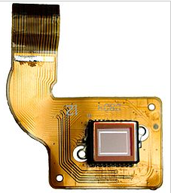
Applications
Photodiode
photons -> electrons
Solar Cell
photons -> electrons
Image Sensor
photons -> electrons -> photons
Notes:
A photodiode is a semiconductor device that converts light into an electrical current. The current is generated when photons are absorbed in the photodiode
Solar cell - a device converting solar radiation into electricity.
Typically, when light strikes the lens of a camera, the image sensor captures that light, converts it into an electronic signal and then transmits it to the camera or imaging device processor, which transforms the electronic signal into a digital image.

Slide 12
Summary
What/How exactly does the photoelectric effect work ?
1921 Nobel Prize in Physics for Albert Einstein.
A lot of applications in real life.

Slide 13

Question

Slide 14
References
https://simple.wikipedia.org/wiki/Photoelectric_effect
https://en.wikipedia.org/wiki/Photoelectric_effect

